Slide 1



Anti Theft and Vehicle Accident Alert System
By:
Harsithram R 23ecr078
1

Slide 2
Description
This project is a vehicle safety and theft detection system using Arduino, GPS, and GSM technology. It detects accidents or unauthorized movements through an accelerometer and instantly alerts the owner via SMS and a phone call, sharing the vehicle's location. Users can also request the vehicle's location remotely by sending a simple SMS command. The system is designed to provide real-time updates and enhance vehicle security with minimal hardware.

Slide 3
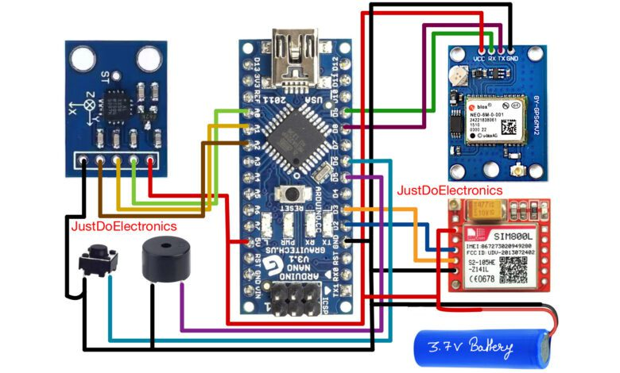

Slide 4
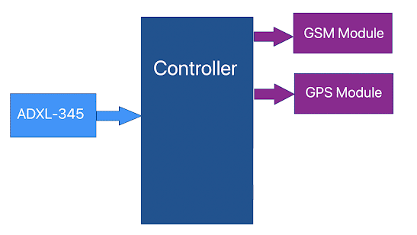

Slide 5
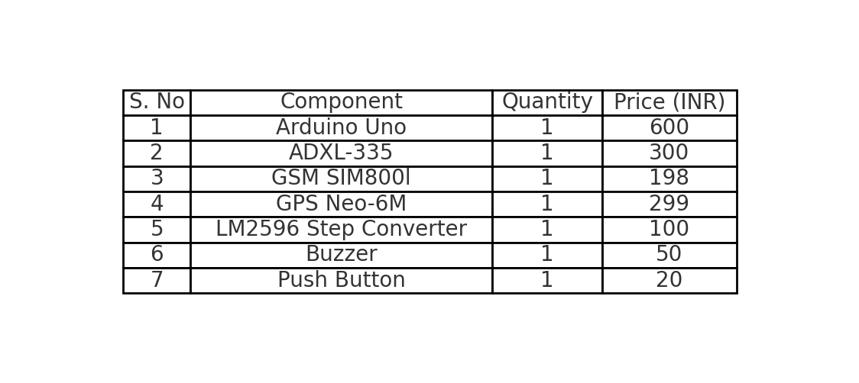
Components Lists

Slide 6
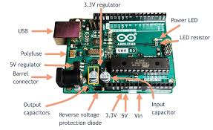
Arduino Uno
Arduino UNO is a low-cost, flexible, and easy-to-use programmable open-source microcontroller board that can be integrated into a variety of electronic projects.
Arduino uses a variant of the C++ programming language. The code is written in C++ with an addition of special methods and functions

Slide 7
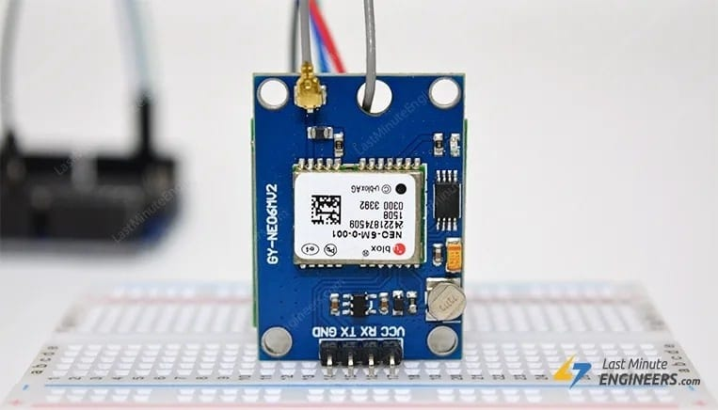
GPS neo 6m v2
By Trilateration process it measures the distance from atleast 3 satellites gives the latitude and Longitude Co-ordinates.
It can track up to 22 satellites over 50 channels and achieve the industry’s highest level of tracking sensitivity i.e. -161 dB, while consuming only 45 mA current. Unlike other GPS modules, it can perform 5 location updates in a second with 2.5m horizontal position accuracy. The U-blox 6 positioning engine also has a Time-To-First-Fix (TTFF) of less than 1 second.

Slide 8
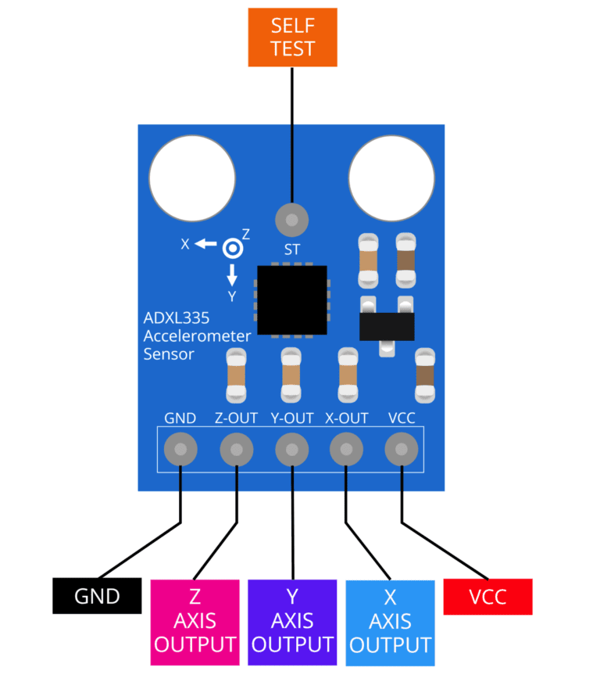
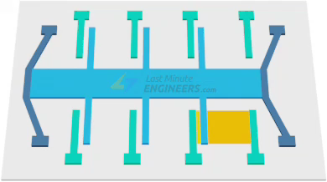
ADXL 335
The ADXL335 is a small, thin, low power, complete 3-axis accelerometer with signal conditioned voltage outputs. The product measures acceleration with a minimum full-scale range of ±3 g. It can measure the static acceleration of gravity in tilt-sensing applications, as well as dynamic acceleration resulting from motion, shock, or vibration. The user selects the bandwidth of the accelerometer using the CX, CY, and CZ capacitors at the XOUT, YOUT, and ZOUT pins. Bandwidths can be selected to suit the application, with a range of 0.5 Hz to 1600 Hz for the X and Y axes, and a range of 0.5 Hz to 550 Hz for the Z axis.

Slide 9
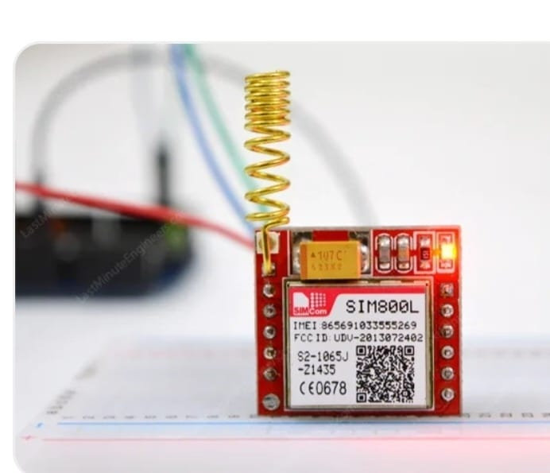
SIM800L GSM/GPRS
The SIM800L GSM/GPRS module is a miniature GSM modem that can be used in a variety of IoT projects. You can use this module to do almost anything a normal cell phone can do, such as sending SMS messages, making phone calls, connecting to the Internet via GPRS, and much more.

